Slide 1
Adding an additional supply voltage on Jetpack
Alex Sludds

Slide 2
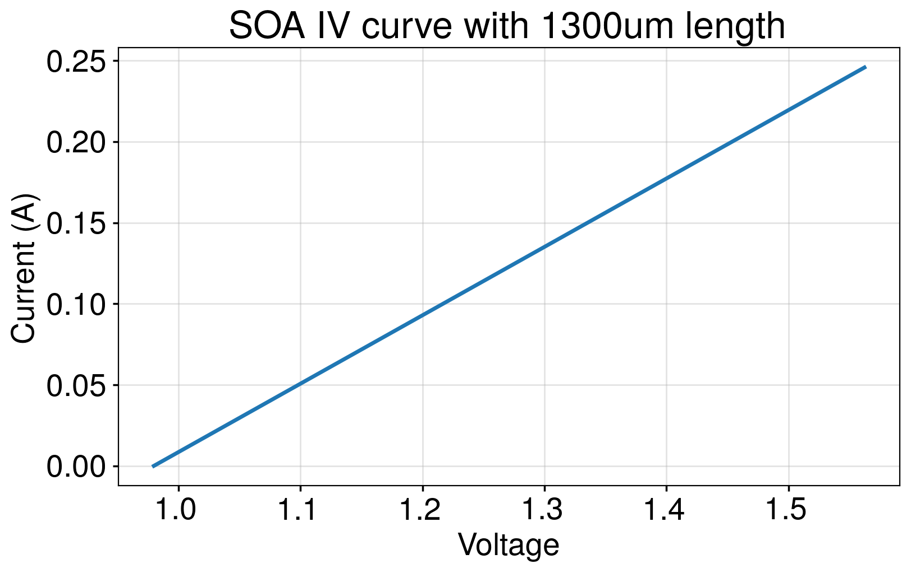
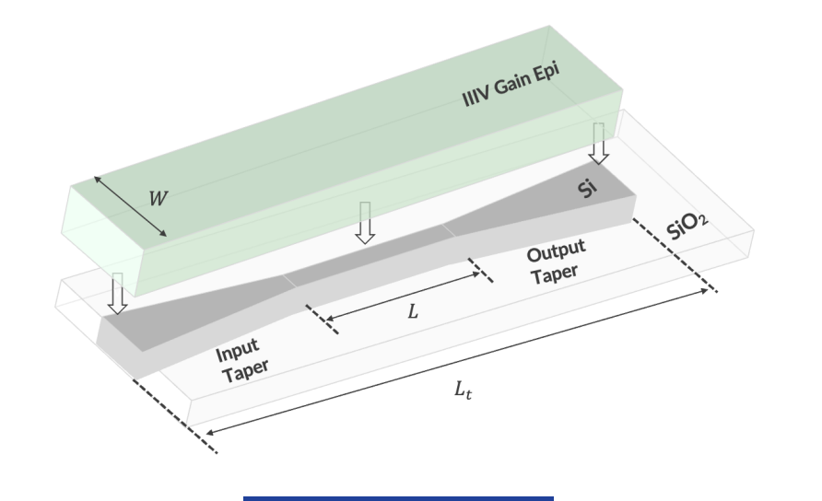
Why would we do this? IV-curve of SOA
This desmos calculator plots J on the x-axis and calculates output current. L is a slider.
It also includes voltage, electrical power dissipation and wall-plug-efficiency estimates
Notes:
J = \frac{I}{W\cdot (L + 2\cdot L_{taper})} = \frac{I}{2.7\mu m \cdot (L + 460\mu m)}

Slide 3
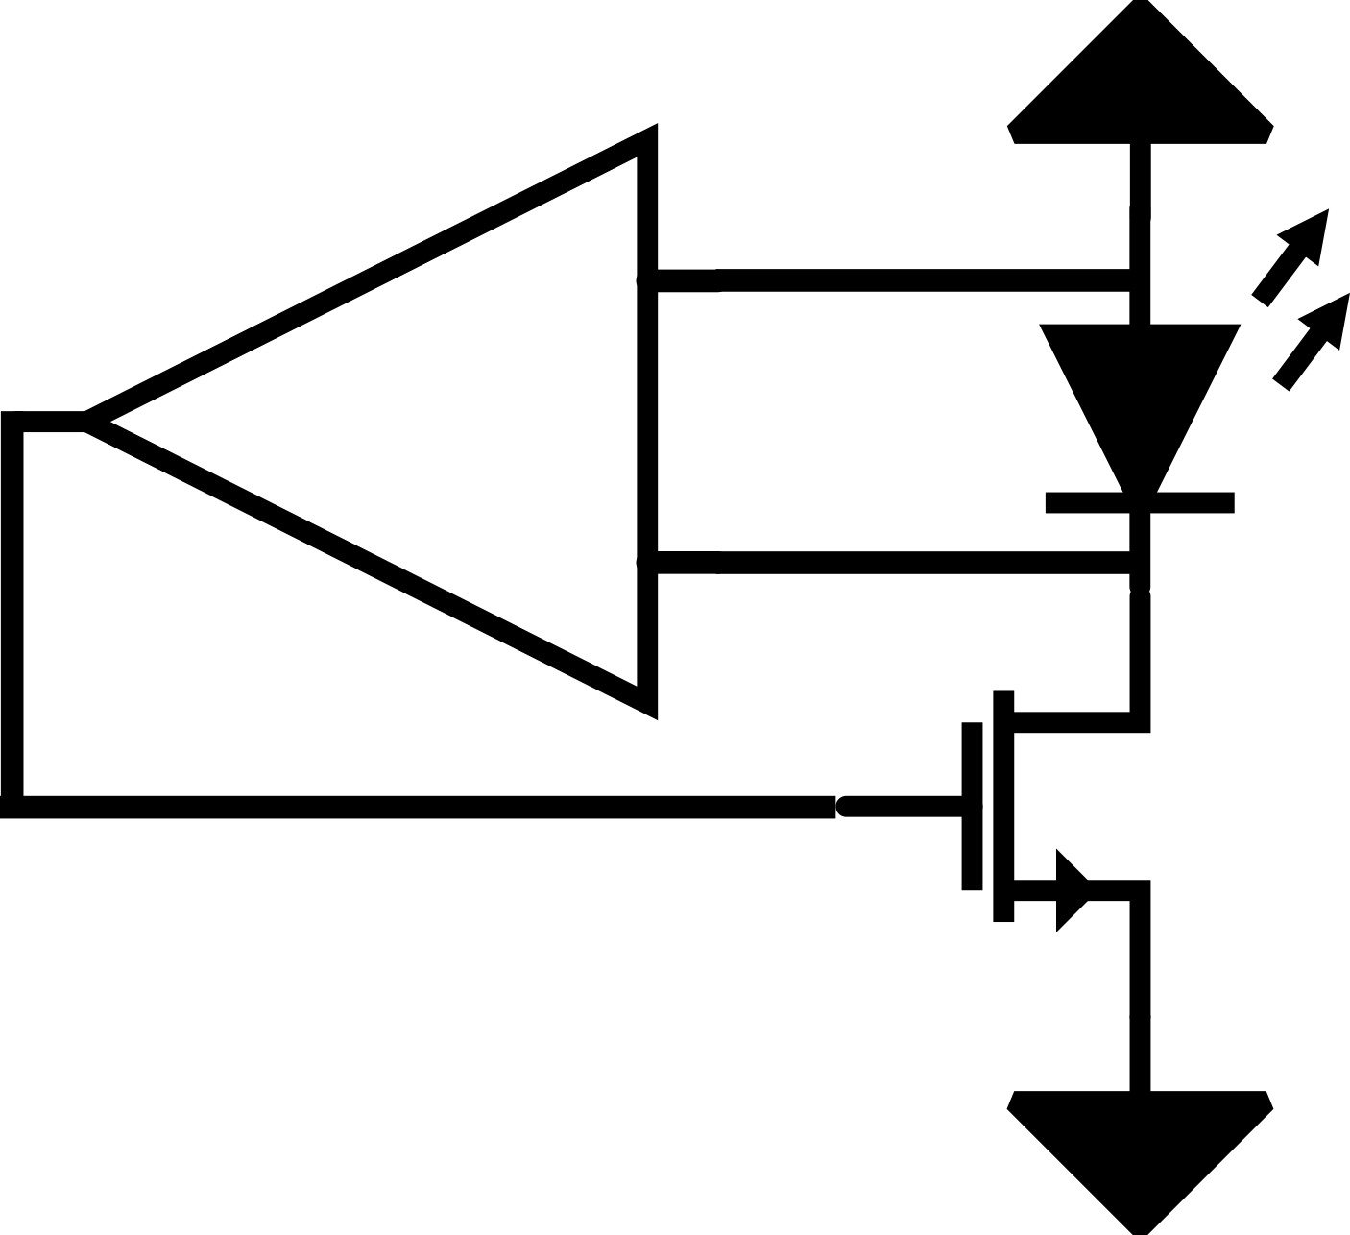
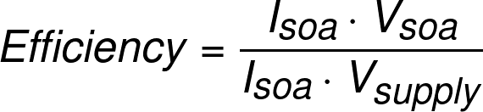
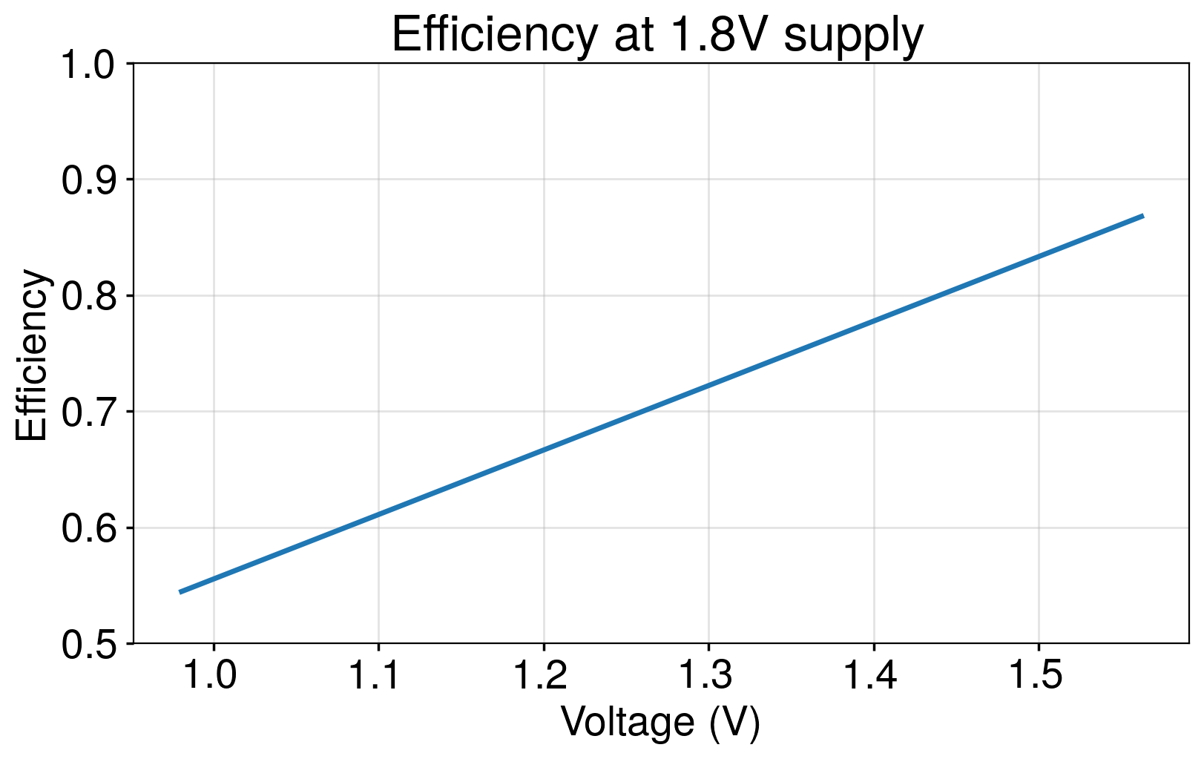
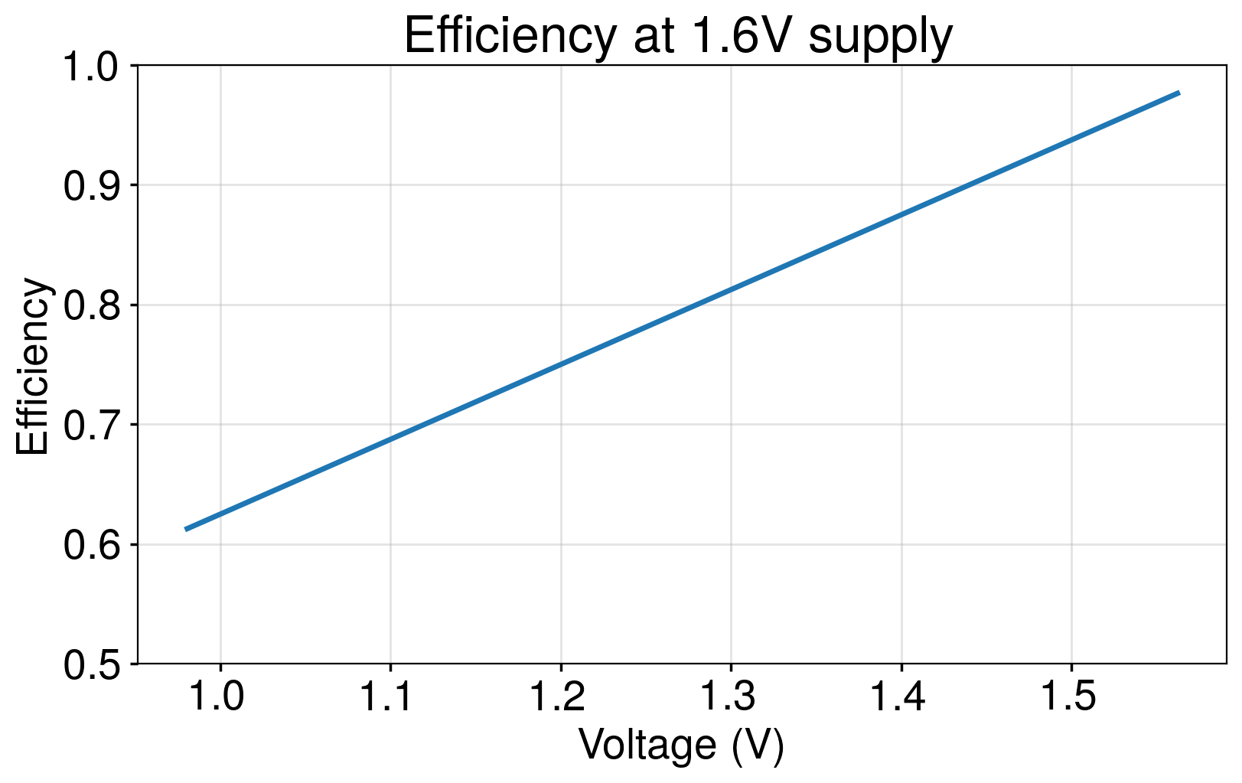
Quantifying Power Efficiency
V_{supply}

